Slide 1
IBM HR Analytics Employee Attrition & Performance
Disclaimer: This analytics is performed using a fictional data set created by IBM data scientists.

Slide 2
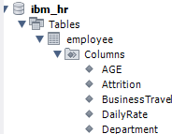
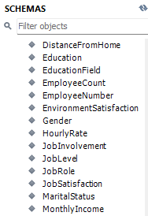
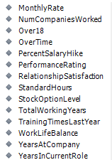

Here are some snippets of schema for reference

Slide 3
BASIC SQL QUERIES

Slide 4


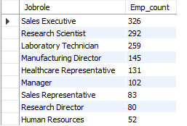

How many employees are there for each 'Job Role'?
What is the average age of employees in the company?

Slide 5




Show the number of employees who have left the company (Attrition = 'Yes').
How many employees are in each department?

Slide 6
MODERATE LEVEL SQL QUERIES

Slide 7

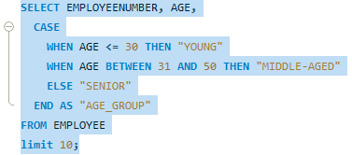
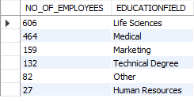
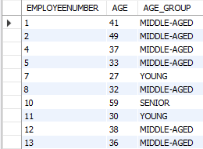
What is the distribution of employees across different education fields (EducationField)?
Create a new column 'Age Group' categorizing employees as 'Young' (<= 30), 'Middle-aged' (31-50), and 'Senior' (> 50) . (Limit 10)

Slide 8
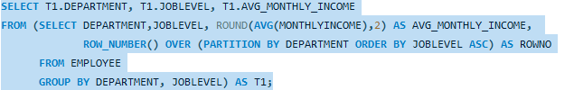


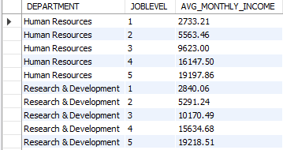

Calculate the average monthly income (MonthlyIncome) of employees of each department for each level.
Calculate the retention rate (percentage of employees who have 'Attrition' as 'No').

Slide 9
ADVANCED LEVEL SQL QUERIES

Slide 10
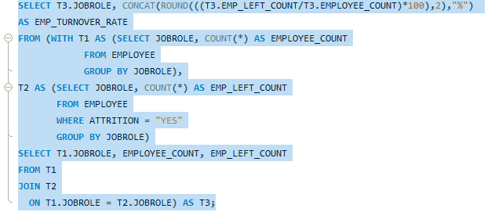
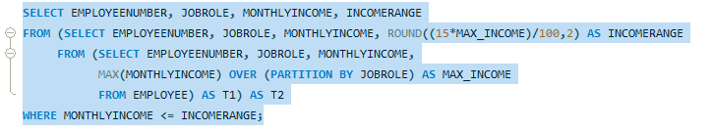
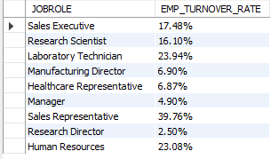
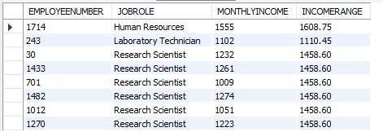
Calculate the turnover rate (percentage of employees who have left) for each job role (JobRole).
Identify employees whose 'Monthly Income' is within 15% of the maximum 'Monthly Income' in their respective 'Job Role'

Slide 11
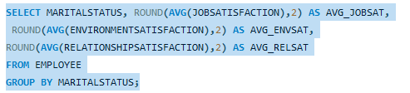
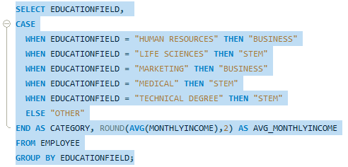

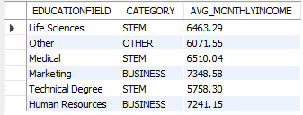
Pivot the data to display average 'Job Satisfaction', 'Environment Satisfaction', and 'Relationship Satisfaction' for each 'Marital Status'.
Calculate the average 'Monthly Income' for employees based on their 'Education Field', grouped into categories ('STEM', 'Business', 'Arts', etc.).

Slide 12
THANK YOU

